Slide 1



A Digital Engineering Company
CONSULTING | DIGITAL SOLUTIONS | IT SERVICES
Solution Architecture
REVAMP
A Division of Gateway Group
WWW.THEGATEWAYDIGITAL.COM
Note: Client logo image is an integral part with sole client ownership.

Slide 2

1.
Architectural system evaluation
Define the technology stack for all platform components
2.
Agenda:
3.
Define a collaboration framework
Defines architecture of the Tuv application
4.
New technology and architecture suggestion
5.

Slide 3
Solution Architecture
OUR ANALYSIS

Slide 4




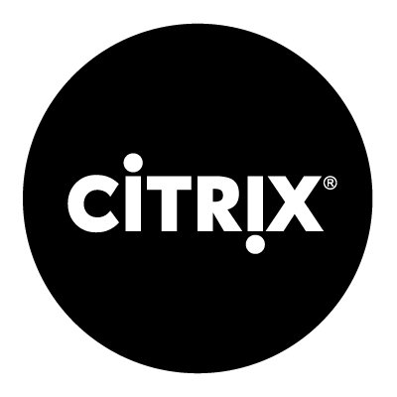
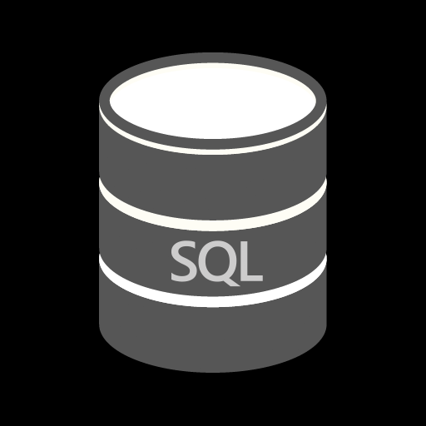
Current Technology
FRONT END
BACK END
WCF
DATABASE
Notes:
Current Technology

Slide 5

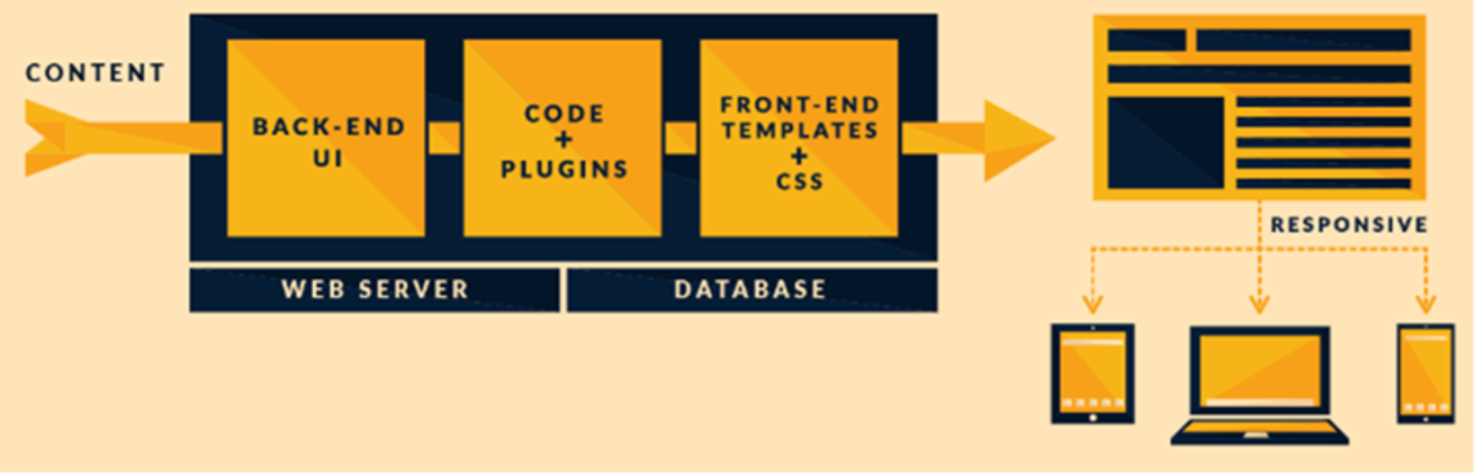
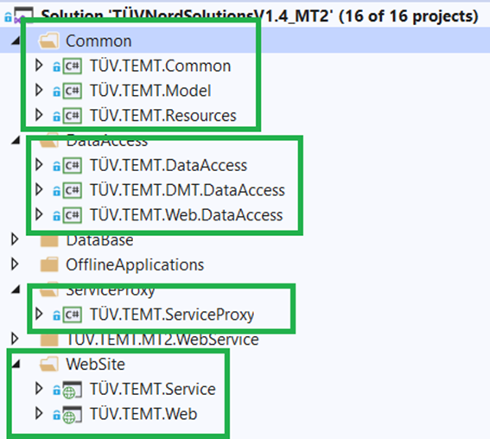
Current Project Structure
Web
Logger, Cache
Service Proxy
Model
WCF
Resources
Data Access
(Manager, Repository)
Notes:
Note:
1) Maintainability
When a monolithic application scales up, it becomes too complicated to understand. Also, a complex system of code within one application is hard to manage.
2) New technology Expansion
It is extremely problematic to apply a new technology in a monolithic application because then the entire application has to be rewritten.
3) Scalability
You cannot scale components independently, only the whole application
4) Making changes
It is harder to implement changes in such a large and complex application with highly tight coupling. Any code change affects the whole system so it has to be thoroughly coordinated. This makes the overall development process much longer.
5) Security
6) Performance

Slide 6
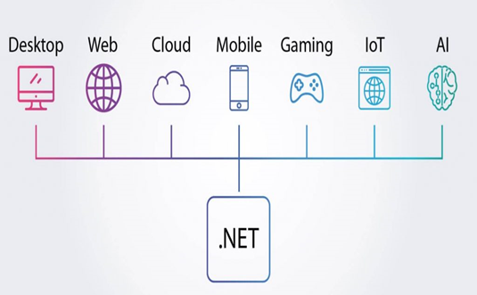
Maintainability
Triggering Factors
Developed with the older technology stack which required more efforts and time to upgrade to the latest version as direct upgrade is not possible due to the MVC framework.
WCF allows a single consistent access to windows communication technologies therefore it’s not possible communicate with mobile device.
Required more effort, time and complexity for decoupling the module from current implementation. It is too big and complex for modular development.
It is harder to implement changes in such a large and complex application with highly tight coupling. Any code change affects the whole system so it has to be thoroughly coordinated. This makes the overall development process much longer.

Slide 7
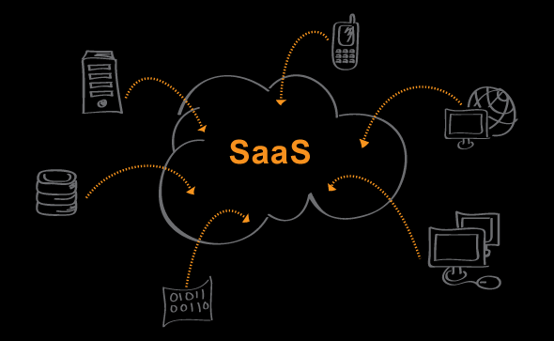
Triggering Factors
New Technology Expansion
Multiple Talent and White label solution implementation is not supported
SaaS : is not supported by current framework
Analytics services
Cloud Storage
Cognitive services
Real time web communication isn’t support by current framework.
Rich User Interface
Power BI
Scalability
You cannot scale components independently, only the whole application (Load Balancing)

Slide 8
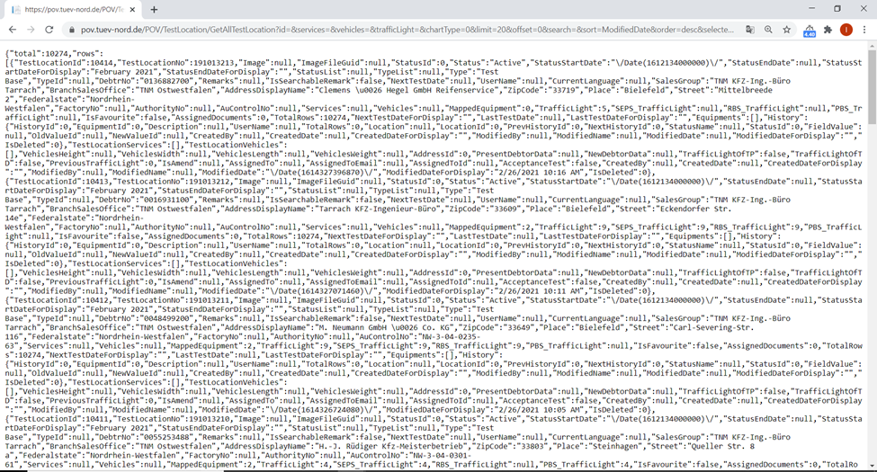
Triggering Factors
Security
Data Access: Back-end WCF Service data access through browser and WCF End directly access without any authentication
URL: https://pov.tuev-nord.de/POV/TestLocation/GetAllTestLocation?id=&services=&vehicles=&trafficLight=&chartType=0&limit=20&offset=0&search=&sort=ModifiedDate&order=desc&selectedIds=

Slide 9
Triggering Factors
Deployment
Manual Deployment: Website deployment on IIS level, need to upgrade technology for cloud deployment.
Cloud technology benefit like Automatic Deployment
Cross Platform deployment is not supported
Test Driven Development is not supported (Automatic check business logic before deployment)
Performance
Page Loading and Data refection issue on different cases of filter functionality

Slide 10
Security
Data Access: Back-end WCF Service data access through browser and WCF End directly access without any authentication
URL: https://pov.tuev-nord.de/POV/TestLocation/GetAllTestLocation?id=&services=&vehicles=&trafficLight=&chartType=0&limit=20&offset=0&search=&sort=ModifiedDate&order=desc&selectedIds=

Slide 11
Proposed Architecture

Slide 12
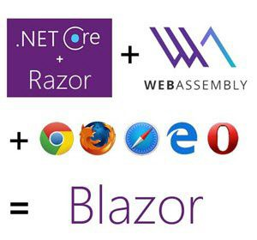
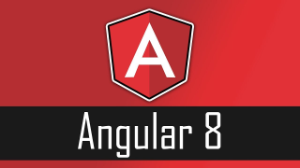
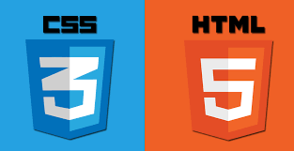














Option2: Tools & Framework
FRONT END
Code Analysis
Or
BACK END
Code
Smell
API
Azure AD
Blob Storage
Azure Key Vault
Microsoft Azure
DATABASE
API TESTING
Notes:
Note:
Independent Front End /Back End (Business layer)
Front End and Back End can be deployed and updated independently, which gives more flexibility.
For Example: A bug or some changes on design has an impact only on front end section, only upload on front module. In this case does not influence the entire application.
Better scalability.
Another advantage of the This approach is that each element can be scaled independently. So the entire process is more cost- and time-effective than with monoliths when the whole application has to be scaled even if there is no need in it. In addition, every monolith has limits in terms of scalability, so the more users you acquire, the more problems you have with your monolith. Therefore, many companies, end up rebuilding their monolithic architectures.
Flexibility in choosing the technology.
The engineering teams are not limited by the technology chosen from the start. They are free to apply various technologies and frameworks
ex: Front End and Back End have different technology.
New Technology Benefits
Compatible with Cloud platforms like Microsoft Azure
Platform Independent Deployment
Better Performance & Response Time
Release dependency
Rich UI Implantation and user friendly interface
https://www.ag-grid.com/
https://demos.devexpress.com/aspxgridviewdemos/Filtering/FilterRow.aspx
Real Time Data Reflection
https://demos.devexpress.com/aspxgridviewdemos/DataBinding/Live.aspx
Better Filter functionality
Drag and Drop Column
Hide Column
Data Summaries
State Persistence
https://demos.devexpress.com/aspxgridviewdemos/Rows/GridLines.aspx
https://js.devexpress.com/Demos/WidgetsGallery/Demo/DataGrid/Overview/Angular/Light/
Many More Component Implementation
HTML Editor
Charts
File Management System
https://js.devexpress.com/Demos/WidgetsGallery/Demo/FileManager/Overview/Angular/Light/

Slide 13
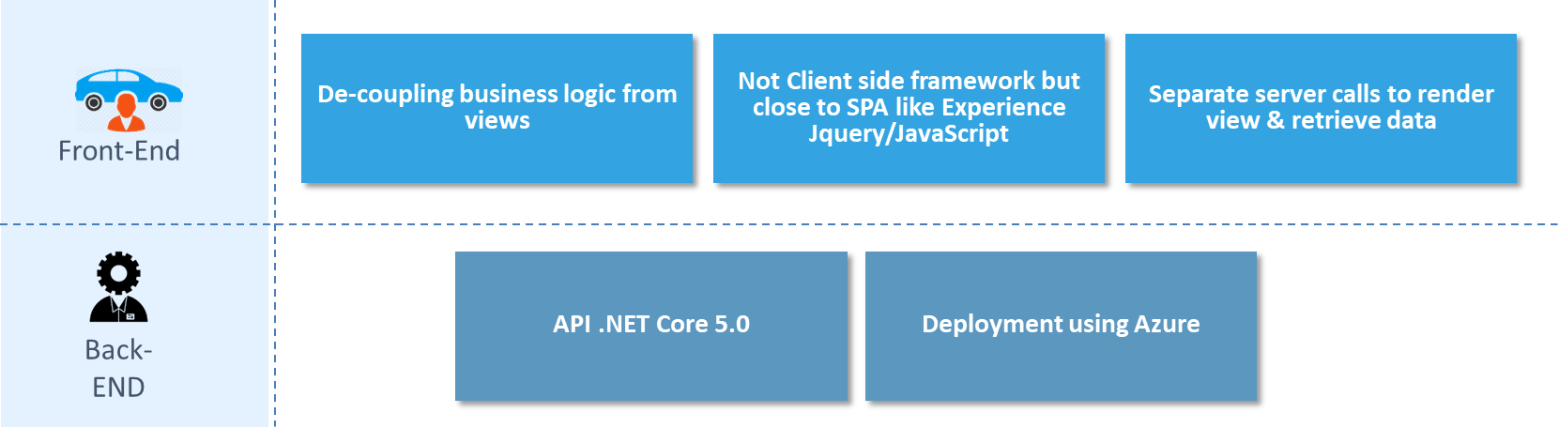
Front-End / Back-End

Slide 14

Architecture
.NET Core Web API
Cross Cutting .
Authorization
Api Controller
API Method 1
Exception
Constructor
API Method 1
Business Model
or
Equipment Model
Common Model
Business Logic
BACK END
Constant
Business Manager
iBusiness
Business Method 1
Business Method 1
Constructor
Business Method 1
Logging
FRONT END
Data Access
iData
Data
Data Method 1
Constructor
Data Method 1
Security
Data Method 1
Database Framework
iRepository
Repository
Repository Method 1
External Services/ Third Party Integration
Helpers
Constructor
Repository Method 1
iServices
Services
Service Method 1
Repository Method 1
Constructor
Service Method 1
Database
Service Method 1

Slide 15
Advantage of Proposed Architecture
Better Scalability
Another advantage of the This approach is that each element can be scaled independently. So the entire process is more cost- and time-effective than with monoliths when the whole application has to be scaled even if there is no need in it. In addition, every monolith has limits in terms of scalability, so the more users you acquire, the more problems you have with your monolith. Therefore, many companies, end up rebuilding their monolithic architectures.
Independent Front End / Back End (Business layer)
Front End and Back End can be deployed and updated independently, which gives more flexibility.
For Example: A bug or some changes on design has an impact only on front end section, only upload on front module. In this case does not influence the entire application.
Flexibility in choosing the technology / New Technology Benefits
The engineering teams are not limited by the technology chosen from the start. They are free to apply various technologies and frameworks ex: Front End and Back End have different technology.
Compatible with Cloud platforms like Microsoft Azure
Platform Independent Deployment, Better Performance & Response Time and Release dependency

Slide 16
Advantage of Proposed Architecture
Rich UI Implantation and user friendly interface
Demo URL
https://www.ag-grid.com/
https://demos.devexpress.com/aspxgridviewdemos/Filtering/FilterRow.aspx
Real Time Data Reflection
https://demos.devexpress.com/aspxgridviewdemos/DataBinding/Live.aspx
Better Filter functionality
Drag and Drop Column
Hide Column
Data Summaries
State Persistence
Modify Components
example:
HTML Editor https://demos.devexpress.com/aspxgridviewdemos/Rows/GridLines.aspx
Charts etc.. https://js.devexpress.com/Demos/WidgetsGallery/Demo/DataGrid/Overview/Angular/Light/
File Management System
https://js.devexpress.com/Demos/WidgetsGallery/Demo/FileManager/Overview/Angular/Light/

Slide 17



Advantage of Proposed Architecture
Provides Agility – Design, Development & Deployment
Easier to scale service. It is possible to scale out individual areas of the application
Better fault isolation
Use the best approach
Deliver value faster
Easier to maintain and deploy
Enables us to choose latest technologies
Supports continuous integration and continuous delivery
Easier to understand
Facilitates code reuse
Easier to integrate with other systems
Enhanced security
Token-based authentication using Oauth2
No more cookie / session based authentication
Release dependency
Moving from monolith to API
Reduce downtime
Moving from application level to module level
Compatible with TDD / CI-CD
Platform Independent Deployment
Better Performance & Response Time
Improve
Performance
Code Reuse
Reduce Downtime

Slide 18
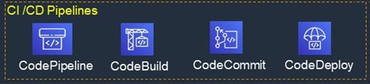
Delivery - CI/CD

Slide 19
Benefits of continuous integration-continuous deployment (CI-CD)
Smaller code changes are simpler (more atomic) and have fewer unintended consequences.
Fault isolation is simpler and quicker.
Mean time to resolution (MTTR) is shorter because of the smaller code changes and quicker fault isolation.
Testability improves due to smaller, specific changes. These smaller changes allow more accurate positive and negative tests.
Elapsed time to detect and correct production escapes is shorter with a faster rate of release.
The backlog of non-critical defects is lower because defects are often fixed before other feature pressures arise.
The product improves rapidly through fast feature introduction and fast turn-around on feature changes.
Upgrades introduce smaller units of change and are less disruptive.
CI-CD product feature velocity is high. The high velocity improves the time spent investigating and patching defects.
Feature toggles and blue-green deploys enable seamless, targeted introduction of new production features.
You can introduce critical changes during non-critical (regional) hours. This non-critical hour change introduction limits the potential impact of a deployment problem.
Release cycles are shorter with targeted releases and this blocks fewer features that aren’t ready for release.
End-user involvement and feedback during continuous development leads to usability improvements. You can add new requirements based on customer’s needs on a daily basis

Slide 20
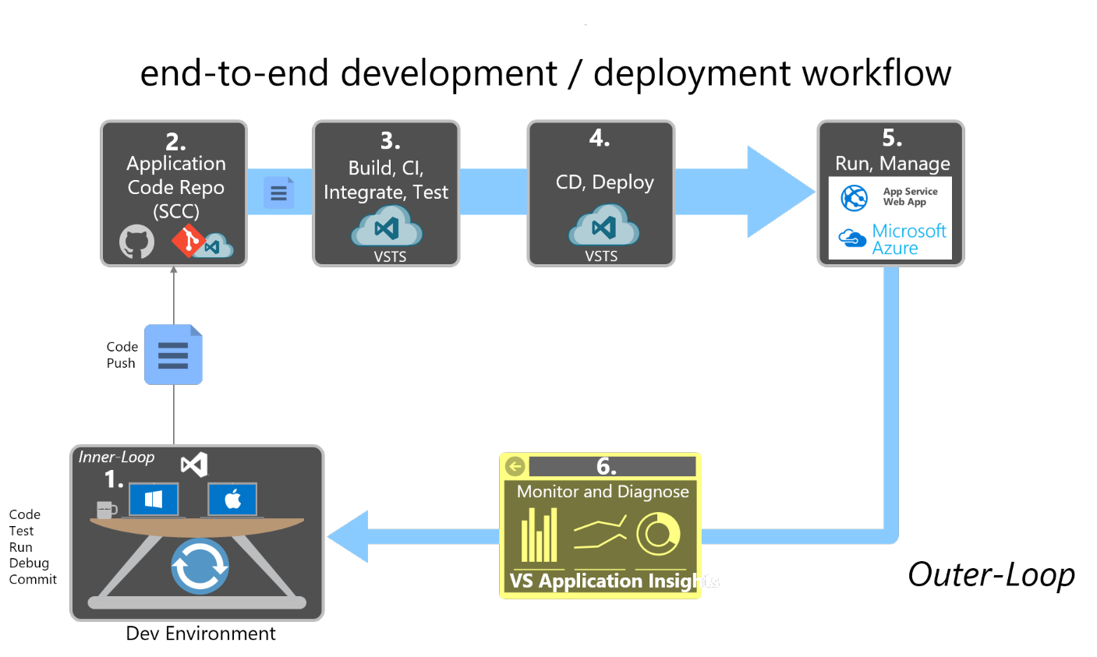
Workflow for developing Azure-hosted
Notes:
https://docs.microsoft.com/en-us/dotnet/architecture/modern-web-apps-azure/development-process-for-azure

Slide 21
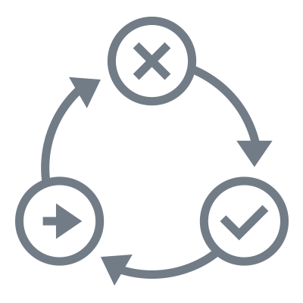
Delivery – TDD
Write
Test
End – to – End
Tests
Refactor
Test
Fails
Integration
Tests
TDD
Unit Tests
(Property based
Testing)
Test
Passes
Write
Code

Slide 22

Thankyou. Let’s Connect Soon
Corporate Headquarters
The Netherlands
Maria Montessorilaan 5, 2719 DB Zoetermeer
Tel: +31 (0) 79 3200 980
India
B/81, Corporate House, Ahmedabad - 380054. India.
Tel: +91 79 2685 2554 / 55 / 56
E-mail: gateway@thegatewaycorp.com
Serving Clients in 16 Countries
BELGIUM
FRANCE JAPAN
SWEDEN
CANADA
GERMANY
NORWAY
THE NETHERLANDS
DENMARK
ICELAND U.K.
UAE
FINLAND
INDIA
SOUTH AFRICA
U.S.A

